Slide 1

Adventure Works Sales Analysis
Group 4

Slide 2
Team members
Sanskriti Watkar
Pavithra M
Akash Bakshi
Mohit Tanwar
S Sharan
Osama Aftab
Syed Hussaini

Slide 3

Agenda
Introduction
ETL Process
Objectives
Analysis
Recommendation & Insights
Dashboard
Conclusion

Slide 4

Introduction
Today we’ll review The analysis of the sales performance of Adventure Works, a multinational manufacturing company. By examining key metrics and the trends, we aim to identify opportunities for growth, optimize sales strategies, and enhance overall business performance. This company Sales analysis involves gaining an understanding of the financial situation of an organization by reviewing the organization's financial statements. It consists of the evaluation of the financial condition, operating performance and the forecasting of its future condition and performance.

Slide 5
ETL Process
Extract
Importing Raw Excel File
Transform
*Removing Unwanted Records with Null Values
*Creating Required Additional Columns
Load
Loading the Transformed Data into Tableau, Power BI and MySQL

Slide 6
Objectives
Sales Channel Analysis
* Compare sales performance across different sales channels (e.g., online, retail, wholesale).
* Identify the most profitable channels and areas for improvement.
* Consider channel optimization strategies (e.g., multi-channel marketing).
Product Performance
* Analyze sales by product category and subcategory.
* Identify top-selling and underperforming products.
* Calculate product-level profitability.
Customer Segmentation
* Segment customers based on demographics, purchase behavior, or other relevant criteria.
* Analyze sales performance by customer segment.
* Identify high-value customer segments for targeted marketing efforts.
Overall Sales Trend
* Analyze the overall sales trend over the past few years.
* Identify periods of growth and decline.
* Calculate year-over-year (YoY) growth rates.
Geographic Analysis
* Analyze sales by region or country.
* Identify high-potential markets for expansion.
* Consider regional marketing and distribution strategies.

Slide 7
KPIs & Insights
Total Sales Amount trended down, resulting in a 90.88% decrease between 2011 2014 and Final profit trended down, resulting in a 90.15% decrease between 2011 and 2014.﻿
We can see there is a sudden dip in sales in 2014 that is droped a lot i.e is from 16.35 to 0.5 we have to focus and try and increase sales
At 32.06 Lakhs, December had the highest Sales Amount and was 85.76% higher than February, which had the lowest Sales Amount at 17.25Lakh and At 9.87Lakh December had the highest profit and was 87.21% higher than February, which had the lowest profit of 5.27lakhs.
December accounted for 10.91% of Total Sales Amount which increased for 10.96% of Final profit on the same month.
﻿Across all 10 Customer Name, Final profit ranged from 3,806.81 to 3,877.91.﻿﻿ ﻿
North America had maximum profit of 3.54M among all the groups.
Year 2013 had accounted for 55.70% of Total Sales Amount and recorded maximum profit of 5.0M.
﻿Tuesday accounted for 14.67% of maximum Profit .﻿
Freight charges are increasing by 45.13% between year 2010 and 2014.

Slide 8
Recommendations
Product Optimization
* Focus on promoting top-selling products and discontinuing underperforming ones. Or we can do that buy analyzing what's wrong with the product
* Consider product bundling and cross-selling opportunities.
* Invest in product innovation and development.
Sales Channel Strategy
* Invest in e-commerce and digital marketing to boost online sales.
* Strengthen partnerships with key retailers and distributors.
* Explore opportunities for omnichannel retailing.
Customer Relationship Management
* Implement a customer loyalty program to retain high-value customers.
* Personalize marketing campaigns based on customer preferences.
* Improve customer service and support.
Geographic Expansion
* Conduct market research to identify new growth markets.
* Adapt marketing and distribution strategies to local preferences.
* Establish strategic partnerships with local distributors.

Slide 9
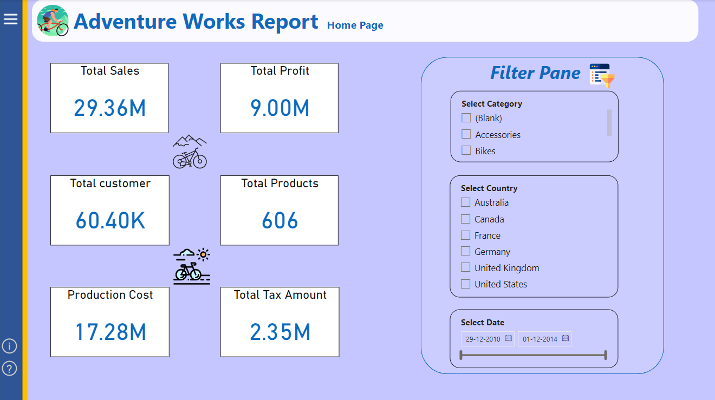
KPIs & Insights

Slide 10
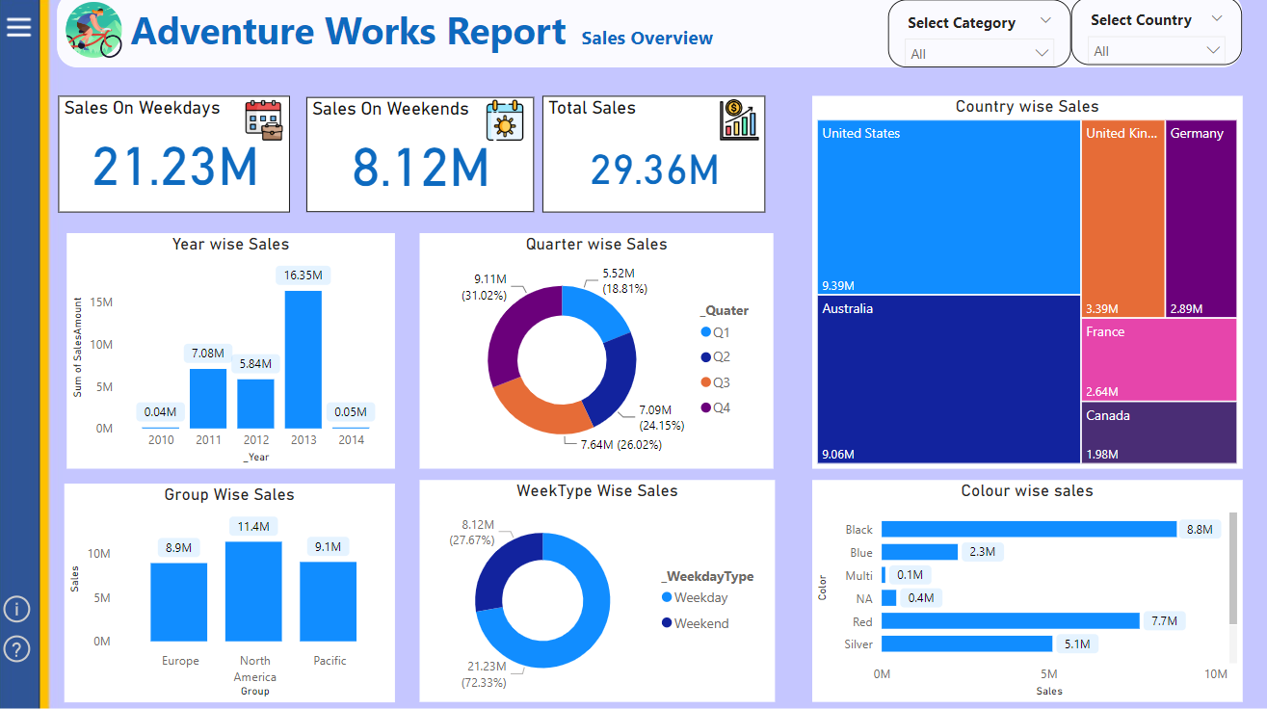
KPIs & Insights

Slide 11
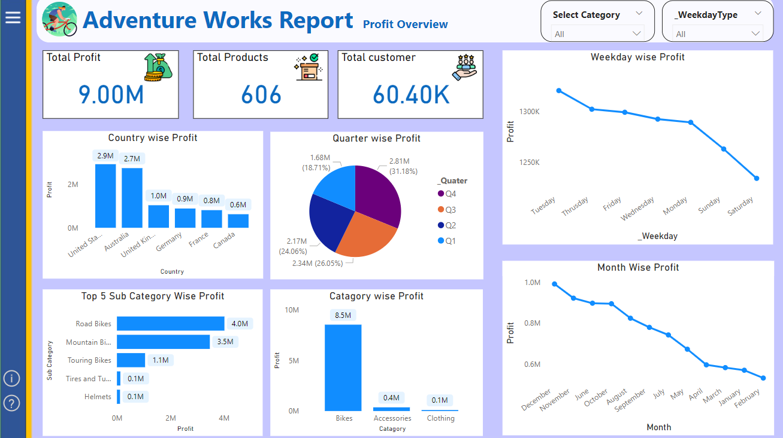
KPIs & Insights

Slide 12
Conclusion
By leveraging the insights gained from this analysis, Adventure Works can make informed decisions to drive sales growth, improve profitability, and enhance customer satisfaction. Continuous monitoring and analysis of sales performance will be crucial to adapt to changing market conditions and maintain a competitive edge. We can see a sudden dip in sales in the year of 2014 we have to understand where we can improve the sales of our product

Slide 13
Thank You

